Slide 1
SPACE MISSIONS DATA VISUALIZATION
BY
MOURYA H M

Slide 2
INTRODUCTION
Space exploration involves the investigation of outer space through the use of astronomy and space technology. It seeks to answer fundamental questions about the universe, our solar system, and the potential for life beyond Earth. Space exploration missions are carried out by governmental space agencies, such as NASA (United States), ESA (European Space Agency), Roscosmos (Russia), CNSA (China National Space Administration), ISRO (Indian Space Research Organisation), and private companies like SpaceX, Blue Origin, and others.
All space missions from 1957 to August 2022, including details on the location, date, and result of the launch, the company responsible, and the name, price, and status of the rocket used for the mission.

Slide 3
ANALYSIS
How have rocket launches trended across time? Has mission success rate increased?
Which countries have had the most successful space missions? Has it always been that way?
Which rocket has been used for the most space missions? Is it still active?
Are there any patterns you can notice with the launch locations?

Slide 4
SCOPE AND OBJECTIVES
Scope:
Exploring planets, moons, asteroids, and other celestial bodies.
Studying space phenomena such as black holes, supernovas, and cosmic microwave background radiation.
Conducting experiments in microgravity.

Slide 5
Objectives:
Planetary Science: To understand the formation and evolution of planets and their potential to support life. Missions like the Mars rovers (e.g., Curiosity, Perseverance) and the Juno mission to Jupiter fall into this category.
Astrobiology: To search for signs of past or present life on other planets and moons, such as Europa, Enceladus, and Mars.
Astronomy: To study distant celestial objects and phenomena, using telescopes like the Hubble Space Telescope and the James Webb Space Telescope.
Solar Physics: To study the sun and its effects on the solar system, exemplified by missions like the Parker Solar Probe.

Slide 6
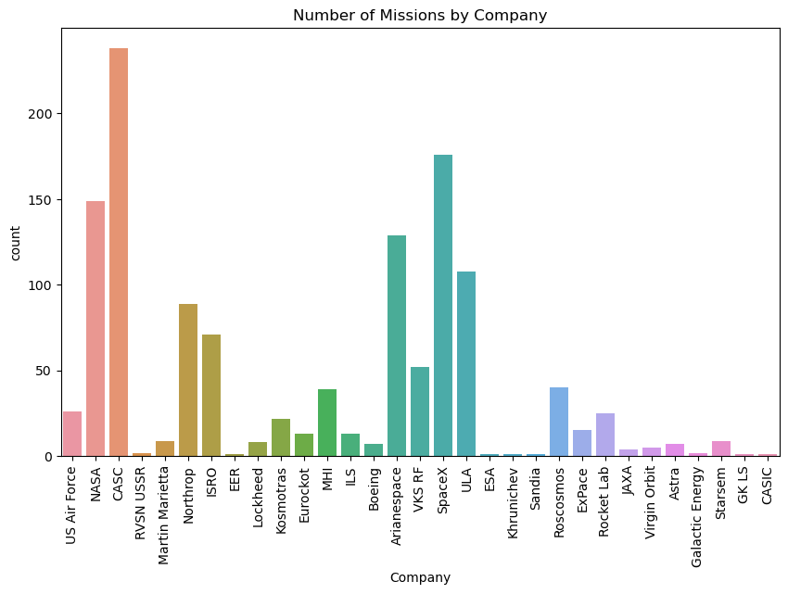
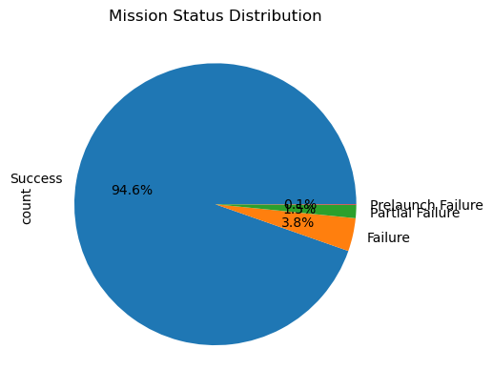
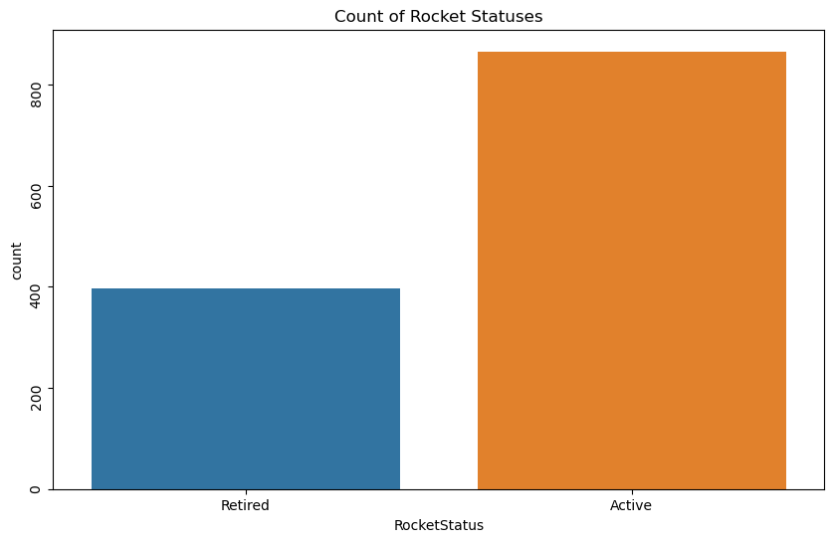
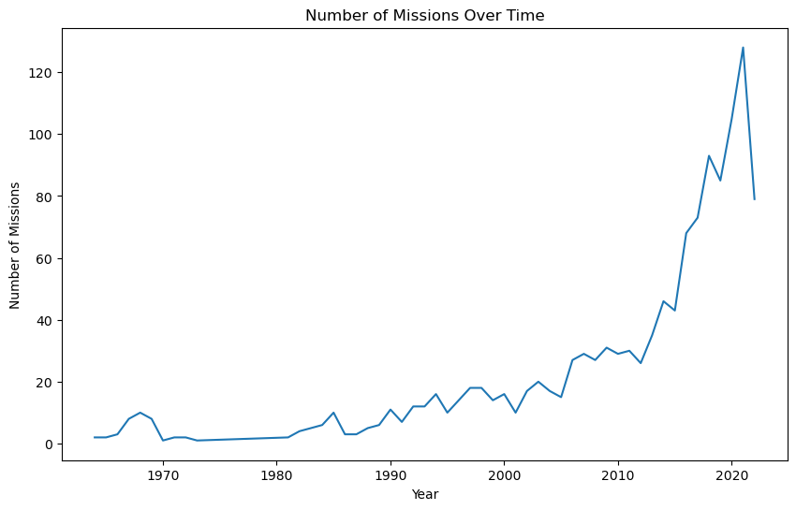
OUTCOMES

Slide 7
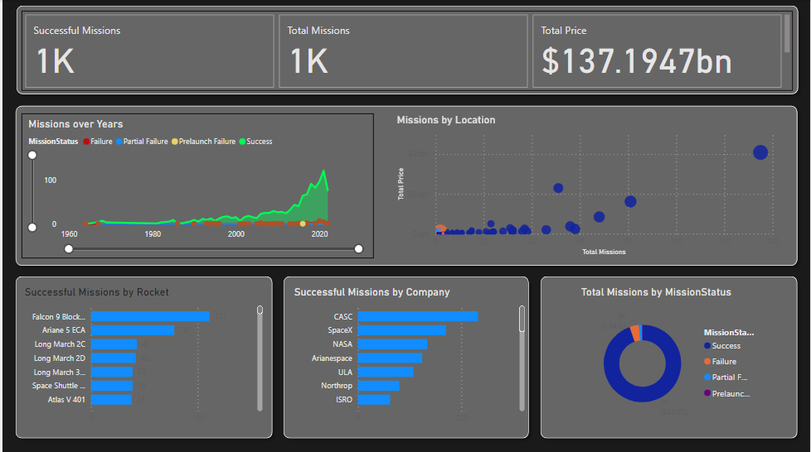
OUTCOMES

Slide 8
CONCLUSION
Space exploration has profoundly expanded our understanding of the universe, driven technological advancements, and inspired humanity. From the first satellite, Sputnik 1, to current missions like the Mars rovers and the Hubble Space Telescope, space missions have provided invaluable data about our solar system and beyond. The ongoing development of human spaceflight, commercial ventures, and future missions to the Moon and Mars highlight the collaborative and ambitious nature of this field. As space exploration continues to evolve, it promises to uncover new scientific insights, foster international cooperation, and pave the way for humanity's sustained presence beyond Earth.

Slide 9
REFERENCES
Dataset File link : https://www.mavenanalytics.io/data-playground?dataStructure=Single%20table&order=date_added%2Cdesc&search=Space%20

